Slide 1
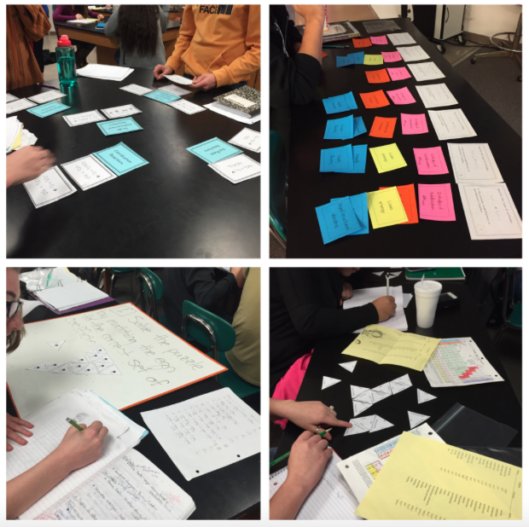
Science Centers for Secondary Classrooms
Presenter: Heather Johnston
Norman Public Schools
Email: htournear@norman.k12.ok.us
Blog: teachingelements.com

Slide 2
What are Science Centers?
Hands-on approach to learning.
Encourages students to experiment and explore using interactive activities.
Access to a variety of learning materials in an interesting and productive manner.

Slide 3
Why use Science Centers?
Students experience how facts and skills relate to the learning targets and goals.
Allows for differentiation (student-centered learning):
    Enrichment and remediation
    Independent or group learning
Increases participation by all students.
Notes:
This enhances their appreciation, understanding, and application of skills and concepts
Differentiation
You can meet the needs of all your students – multiple levels of learning at one time
Encourage collaboration – careers today require people to work together, begin developing those skills in the classroom!
All students are moving around and are accountable for completing each center (or designated amount) – they can’t hide in their desk because you were busy on the side of the room

Slide 4
Why use Science Centers?
Learning can be less intimidating
Frees teacher
Budget issues? No problem!
Keeps students engaged and they must take ownership of their learning
    Be sure to create a safe learning environment!
Notes:
Learning is broken into digestible chunks, more manageable learning
Frees teacher – traveling the room is easier; provide direction, clarify questions, one-on-one discussion, quickly gauge were students are in their understanding
Low budgets affect the resources and materials we have access to – if you don’t have enough items for the whole class to participate at once, you can make it 1 or 2 of the stations. That way you ensure student understanding
Students have to complete centers and move around the room during class; if they don’t finish they’ll realize there are consequences (can’t take home centers, will have to come in during lunch to finish, etc…)

Slide 5
Developing Science Centers
Steps
1st: Pick a Learning Goal (standard) or Learning Target(s)
2nd: Diversify the Learning Experience
3rd: Parts of a Science Center
4th: Implementation
5th: Assessment

Slide 6
Step 1: Pick Learning Goal or Learning Target(s)
Learning Goal = Standard
Learning Target(s) = steps toward the standard
A science center is an activity that leads students to an understanding of the target or goal.
Example: Students will be able to construct and revise an explanation for the outcome of a simple chemical reaction based on the outermost electron states of atoms, trends in the periodic table, knowledge of that patterns of chemical properties, and formation of compounds.
Notes:
This step is identifying what you want to teach
Are you assessing a learning goal/standard?
Or are you working on a learning target(s)
If you have learning scales this step is easy because you have already broken your standard into digestible chunks. If not then you should definitely look into this! Makes teaching more explicit and intentional. I love it!
Science centers can encompass the end results of the learning goal but they are not typically used as a summative assessment of student understanding/ability.
Example: HS-PS1-4

Slide 7
Step 2: Diversify the Learning Experience
3-Dimensional Learning
    Disciplinary Core-Ideas
    Cross-Cutting Concepts
    Science and Engineering Practices
Gathering – Reasoning – Communication
5-E Instructional Model
    Engage, Explore, Explain, Elaborate, Evaluate
Bloom’s Taxonomy
Notes:
Once we know what we want our students to understand or be able to do we need to develop a variety of activities/questions that address it.
There are several different ways you can do this:
3-D Learning → engaging students in progressively deeper understandings of science and the abilities they need to make sense of phenomena in the natural and designed world
CCC: Patterns, Cause/Effect, Scale/Proportion/Quality, Systems/System Models, Matter & Energy, Structure/Function, Stability/Change
SEP: Asking Questions/Defining Problems, Developing models, Planning and carrying out investigations, analyzing and interpreting data, using mathematics and computational thinking, constructing explanations (science) and designing solutions (engineering), engaging in argument from evidence, obtaining/evaluating/communicating information
GRC – Brett Moulding → incorporates 3D learning as a part of gathering, reasoning, and communication
5E Instructional Model
Engagement - students’ prior knowledge accessed and interest engaged in the phenomenon
Exploration - students participate in an activity that facilitates conceptual change
Explanation - students generate an explanation of the phenomenon
Elaboration - students' understanding of the phenomenon challenged and deepened through new experiences
Evaluation - students assess their understanding of the phenomenon
Bloom’s Taxonomy → Remembering, understanding, applying, analyzing, evaluating, and creating

Slide 8
Step 2: Diversify the Learning Experience
Or, are you short on time?
  Break worksheets up and do group rotations
  Layer a lab by increasing the difficulty
Regardless of how you design the activity each Science Center can be a different type of activity:
  Modeling, Technology, Physical Movement, Reading, Reflection, Observing, Graphing, etc..
Notes:
Students complete the first problem, rotate to the next table check the previous groups work then solve the next problem Groups initial the problems they check and solve. You only need 2 worksheets for this activity so that students are mentally engaged with each problem (they can’t just compare what they did before to the next groups).
Rxn Rate lab → T models S expectations while they follow along, then provide framework for students to solve a problem on their own, and lastly just provide the question. The summative assessment for this concept is designing, conducting, collecting data, and communicating the info obtained for a new lab.

Slide 9
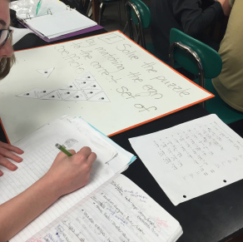
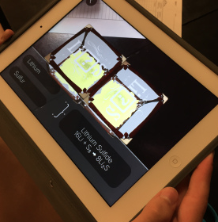
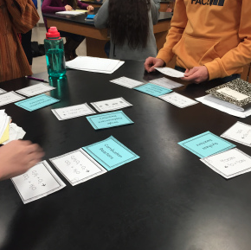
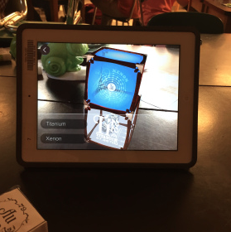
Step 2: Diversify the Learning Experience
Example for HS-PS1-4: Students will be able to construct and revise an explanation for the outcome of a simple chemical reaction…
Notes:
**Not pictured: writing correct formulas, identifying ions that form the compounds, and identifying mistakes

Slide 10
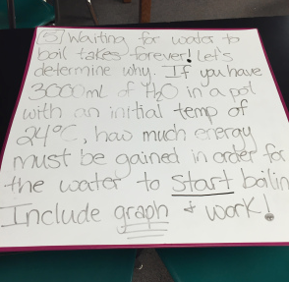
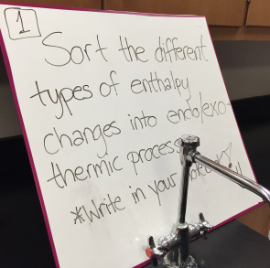
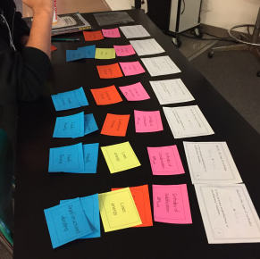
Step 2: Diversify the Learning Experience
Example for HS-PS3-4: Students will be able to plan and conduct an investigation to provide evidence…
Notes:
**Not pictured: writing correct formulas, identifying ions that form the compounds, and identifying mistakes

Slide 11
Step 3: Parts of a
Science Center
Title/Number for Station
Materials needed – include learning target for each station (if there are different ones)
Include directions!
How will students let you know they have a question?
Notes:
Makes it easier to identify centers; easier for students to keep track of what they have completed
Learning target helps remind Ss what the focus is for each activity
How many times do we have to explain things? Now imagine doing that for each center in your classroom, ah!! Leave directions at each center if it’s needed.

Slide 12
Step 4: Implementation
Arrangement of Centers
Sequencing
Assign students certain centers or let them decide
Grouping Students – Be Flexible!
Duration for each center
Have a Break Center
Notes:
Are the centers arranged in such a way that allows of easy movement between?
Do centers need to be completed in a certain order?
Groups can be fluid! Size of group depends on number of stations and what your end goal of the activity is.
You can give each center a specific timeline (counter on board) or just tell them they need to finish by the end of the hour/next day, etc…
Give students the option of a break center – they can use this time as reflection on previous questions, time to complete unfinished questions, or simply as a break – be sure to give this center a time limit!

Slide 13
Step 4: Implementation
Teacher can work with students individually or in small groups
Provide students with a “Road Map”
  Outlines station progression
  Check off place for teacher signature or a stamp
Student accountability
Notes:
Teachers move through the room providing help when needed, ask leading questions, check student progress

Slide 14
Step 5: Assessment
How do you want students to demonstrate that they are doing the work/learning?
Use a Clipboard
  Document student understanding
  Formative assessments
Informal class discussion
Summative assessments
Notes:
What evidence will you use to identify if students are learning the desired targets/goals?
Documenting what you see as you move around the room helps inform your next steps.

Slide 15
Sounds Great! Any Cons?
Time for organization and preparation
Classroom time management
Space → storage and classroom arrangement
Notes:
Does take some time to organize and prepare for the science centers
In the beginning it can take longer because it is new, however both you and your students will eventually get used to the process so the amount of “up-front” time will decrease.
2nd year + won’t take as long either because it would’ve been done the year before! You just may need to make some slight tweaks based on your reflections
Time management – it’s a different way to interact with skills and concepts, you may feel as if you are spending too much time on something but remember you’ve combined assignments. So if your worksheets typically took a week to complete spending 3 days on a set of science centers isn’t wasting time. You are giving students more application and interaction with the centers than simply answer questions in a particular order on a worksheet.
Organize your classroom into centers vs daily arrangement

Slide 16
Pro’s Outweigh the Cons
Student centers facilitate student learning growth by utilizing their interests and needs as a guide for meaningful instruction.
Allows for student choice
Encourages students to experiment and explore….and maybe have a little fun with science! ☺

Slide 17
Resources
Google “Science Centers in Secondary Classrooms” or “Learning/Activity Centers”
Designing Effective Activity Centers for Diverse Learners: A Guide for Teachers at All Grade Levels and for All Subject Areas.
    http://manoa.hawaii.edu/coe/crede/wp-content/uploads/Hilberg_et_al_20031.pdf
Notes:
Many free resources online – just use Google!
Free PDF by the Center for Research on Education, Diversity, and Excellence
Contains middle-level examples and guides that can be altered to fit your classroom

Slide 18
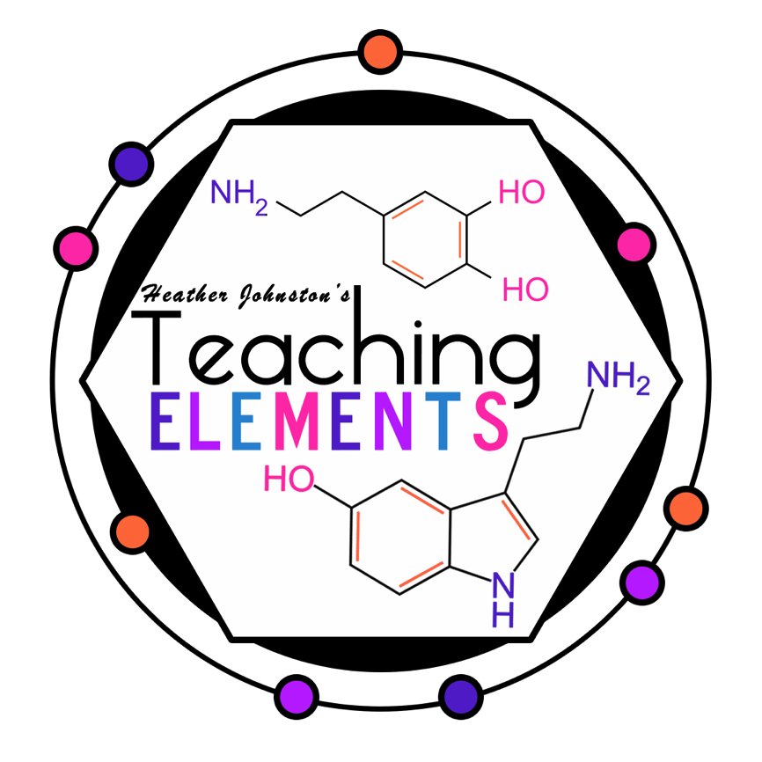
Questions???
Presenter: Heather Johnston
Email: htournear@norman.k12.ok.us
Blog: teachingelements.com

